Slide 1
Microwave and Satellite Communication
CSTE 3203

Slide 2
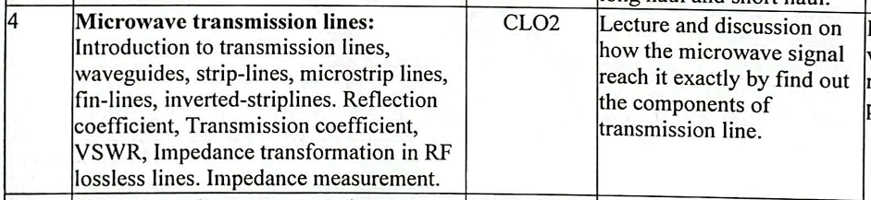

Slide 3
Transmission line equation
Based on transmission line equations one can identify parameters of Tx line.
Characteristic impedance
Propagation constant
Phase constant
Attenuation constant
Reflection co-efficient
And VSWR

Slide 4
Relation between Propagation constant, phase constant and attenuation constant

Slide 5



Slide 6
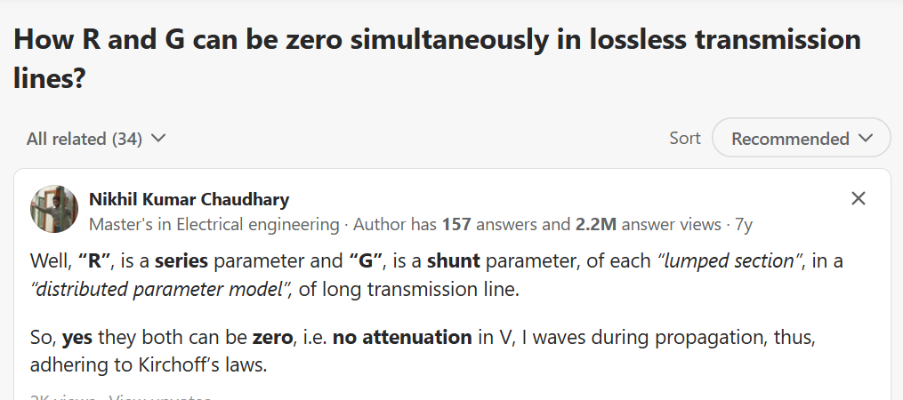

Slide 7
Characteristic impedance derivation

Slide 8
Characteristic impedance
Characteristic impedance Z₀ is the impedance of the transmission line measured at input or output, provided the length of the transmission line is infinite.

Slide 9
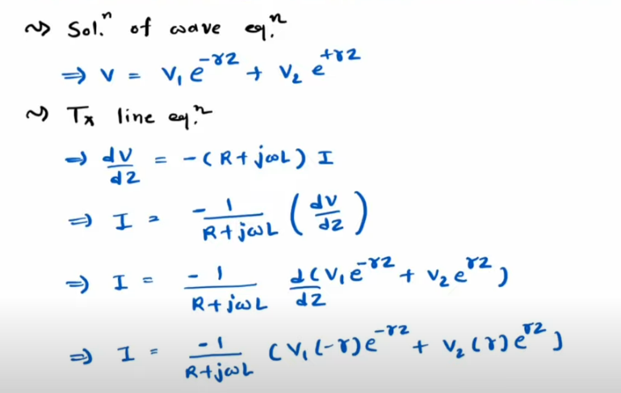

Slide 10
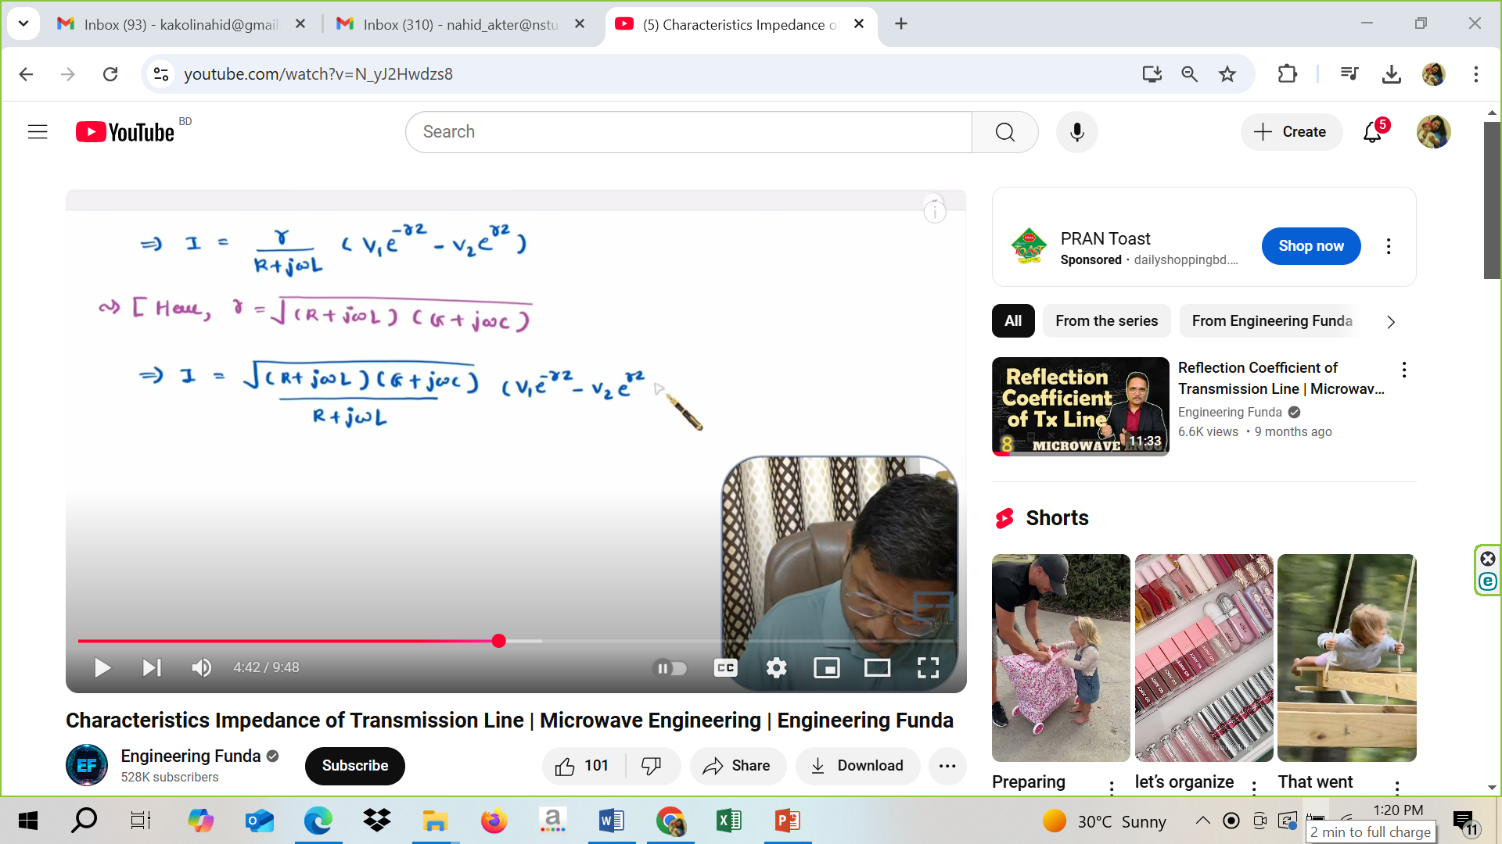

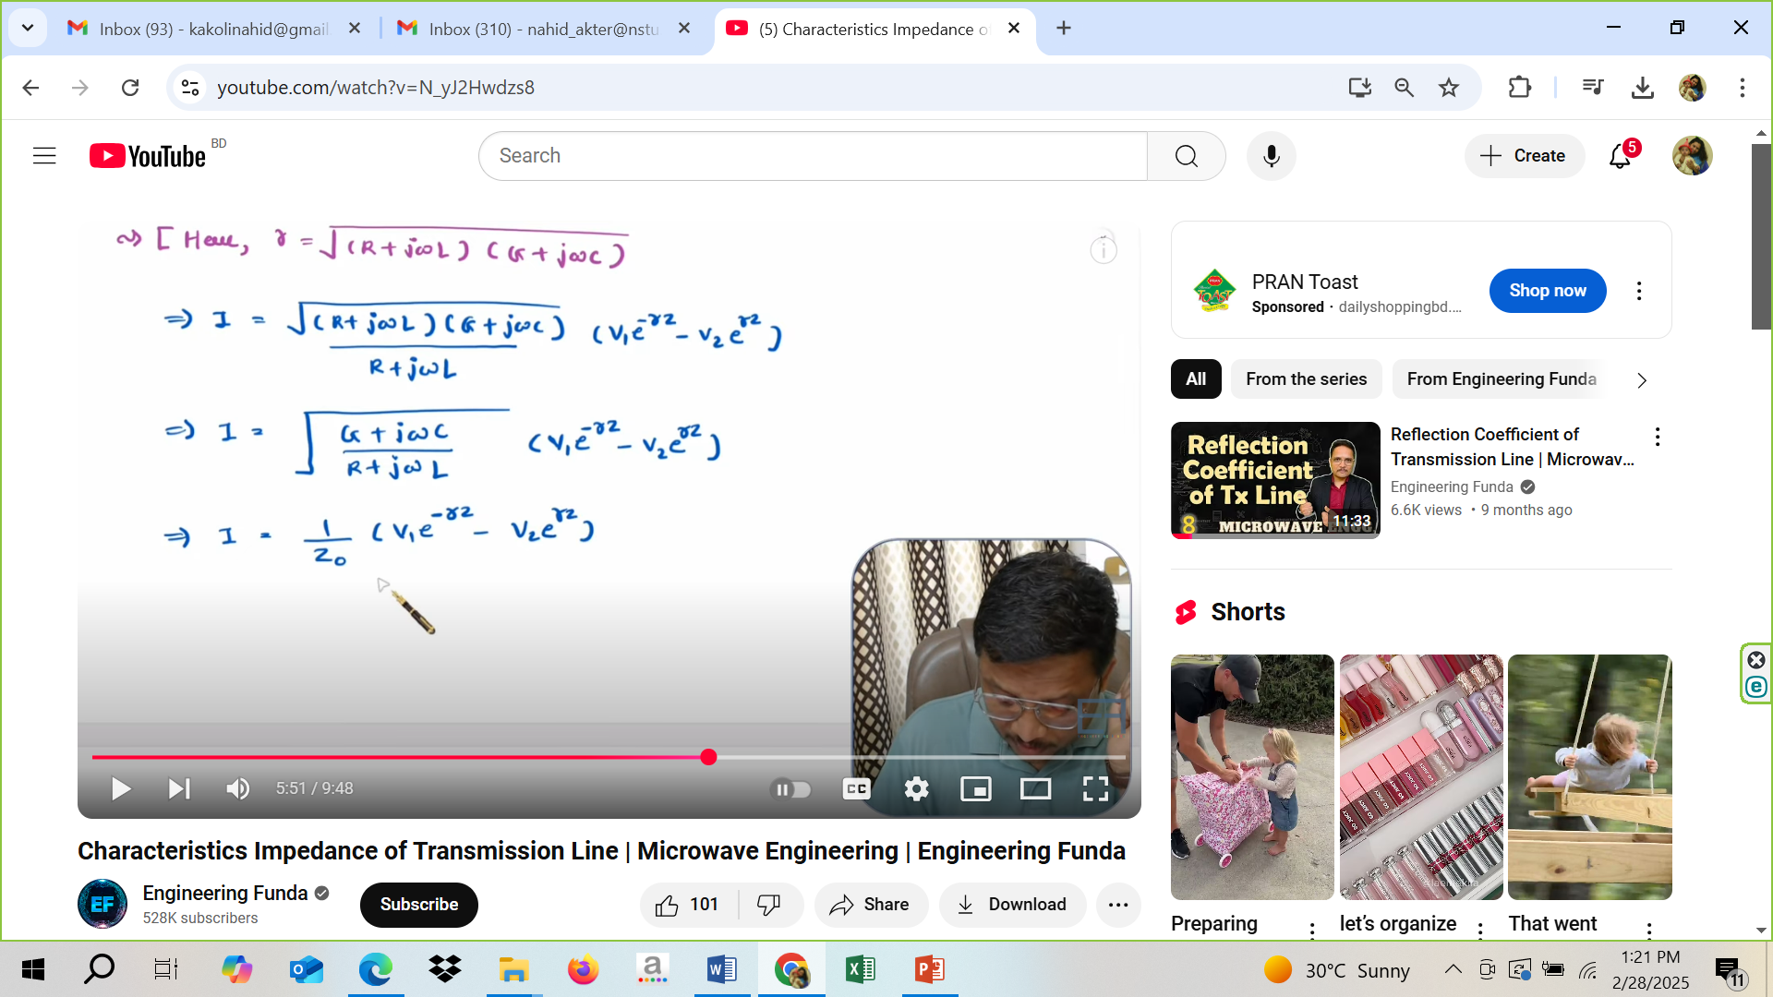


Slide 11
Input impedance formula

Slide 12


Slide 13
Reflection Coefficient Derivation

Slide 14
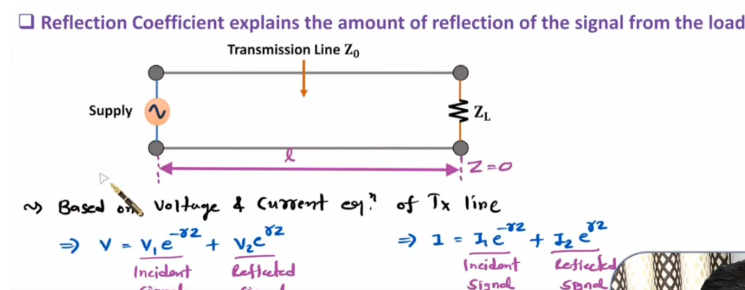

Slide 15
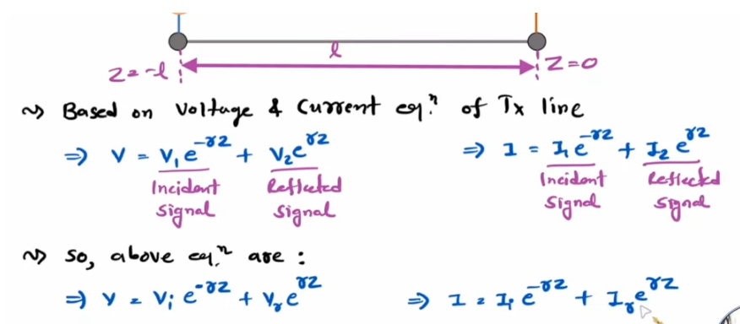

Slide 16
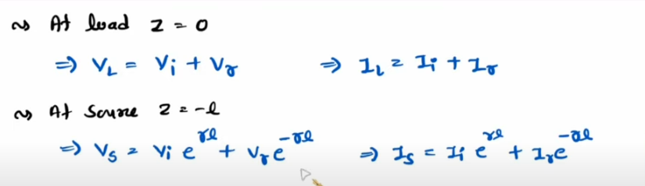

Slide 17
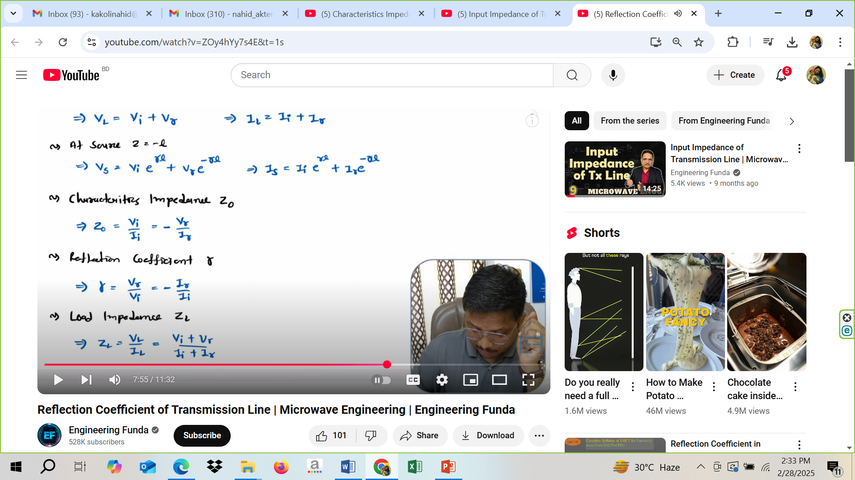

Slide 18
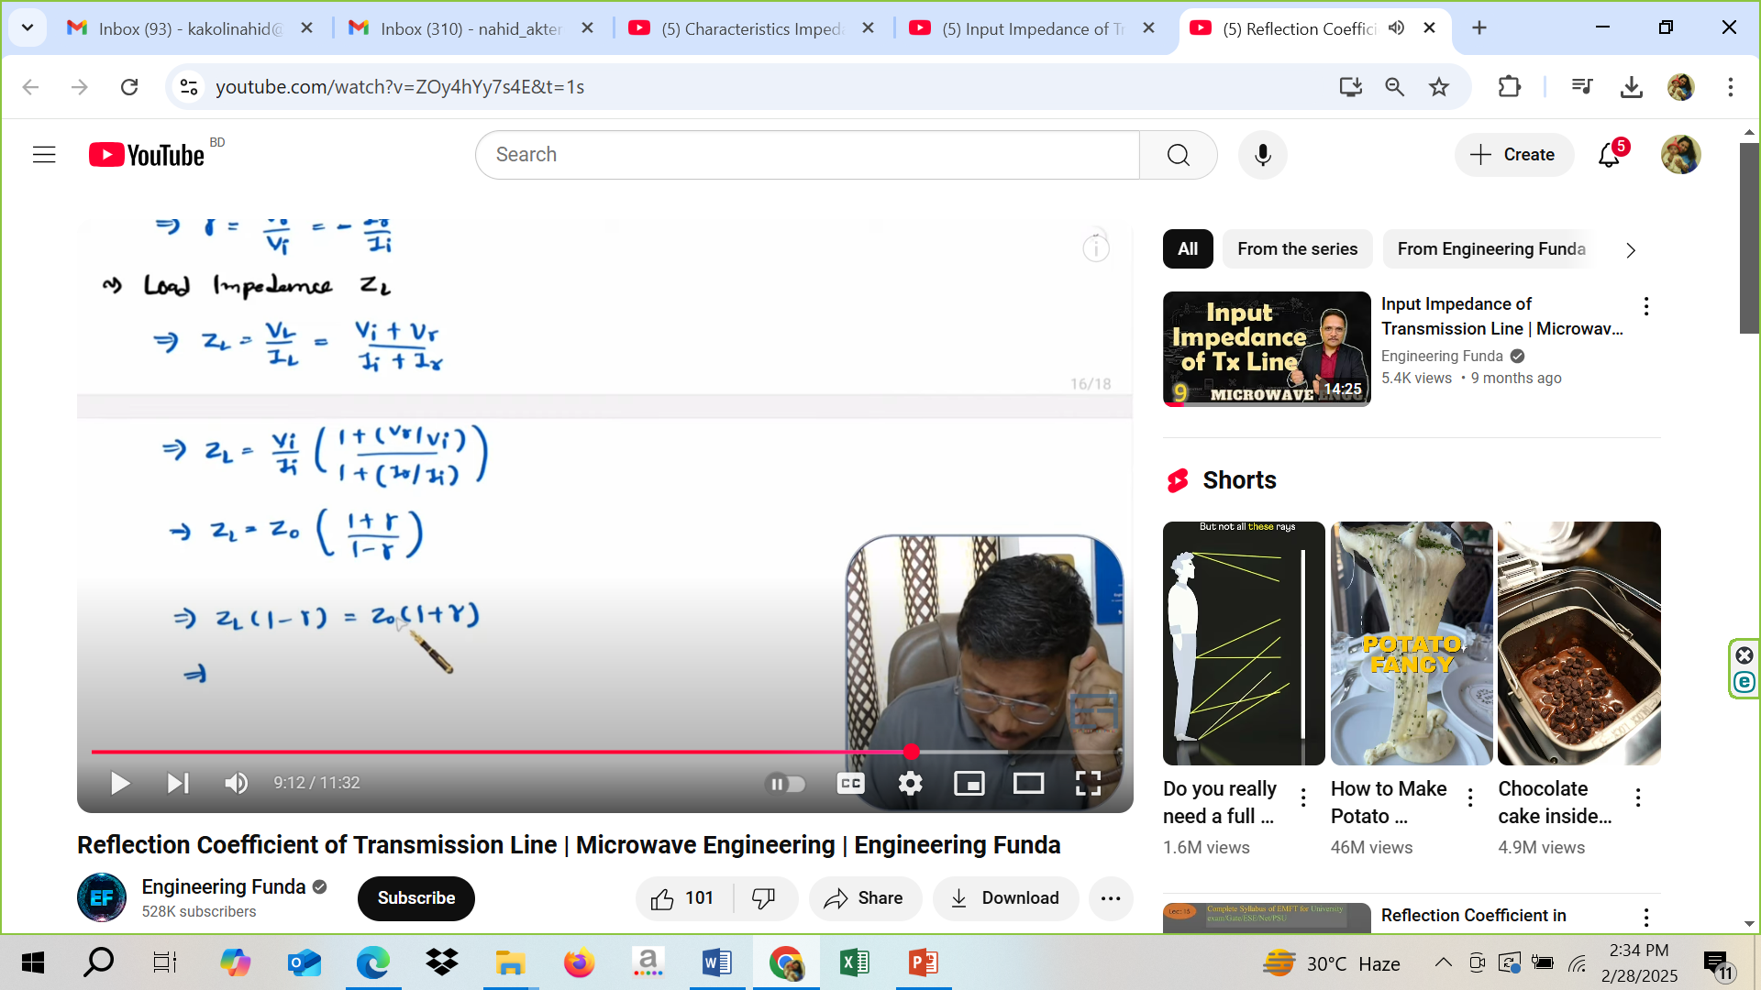

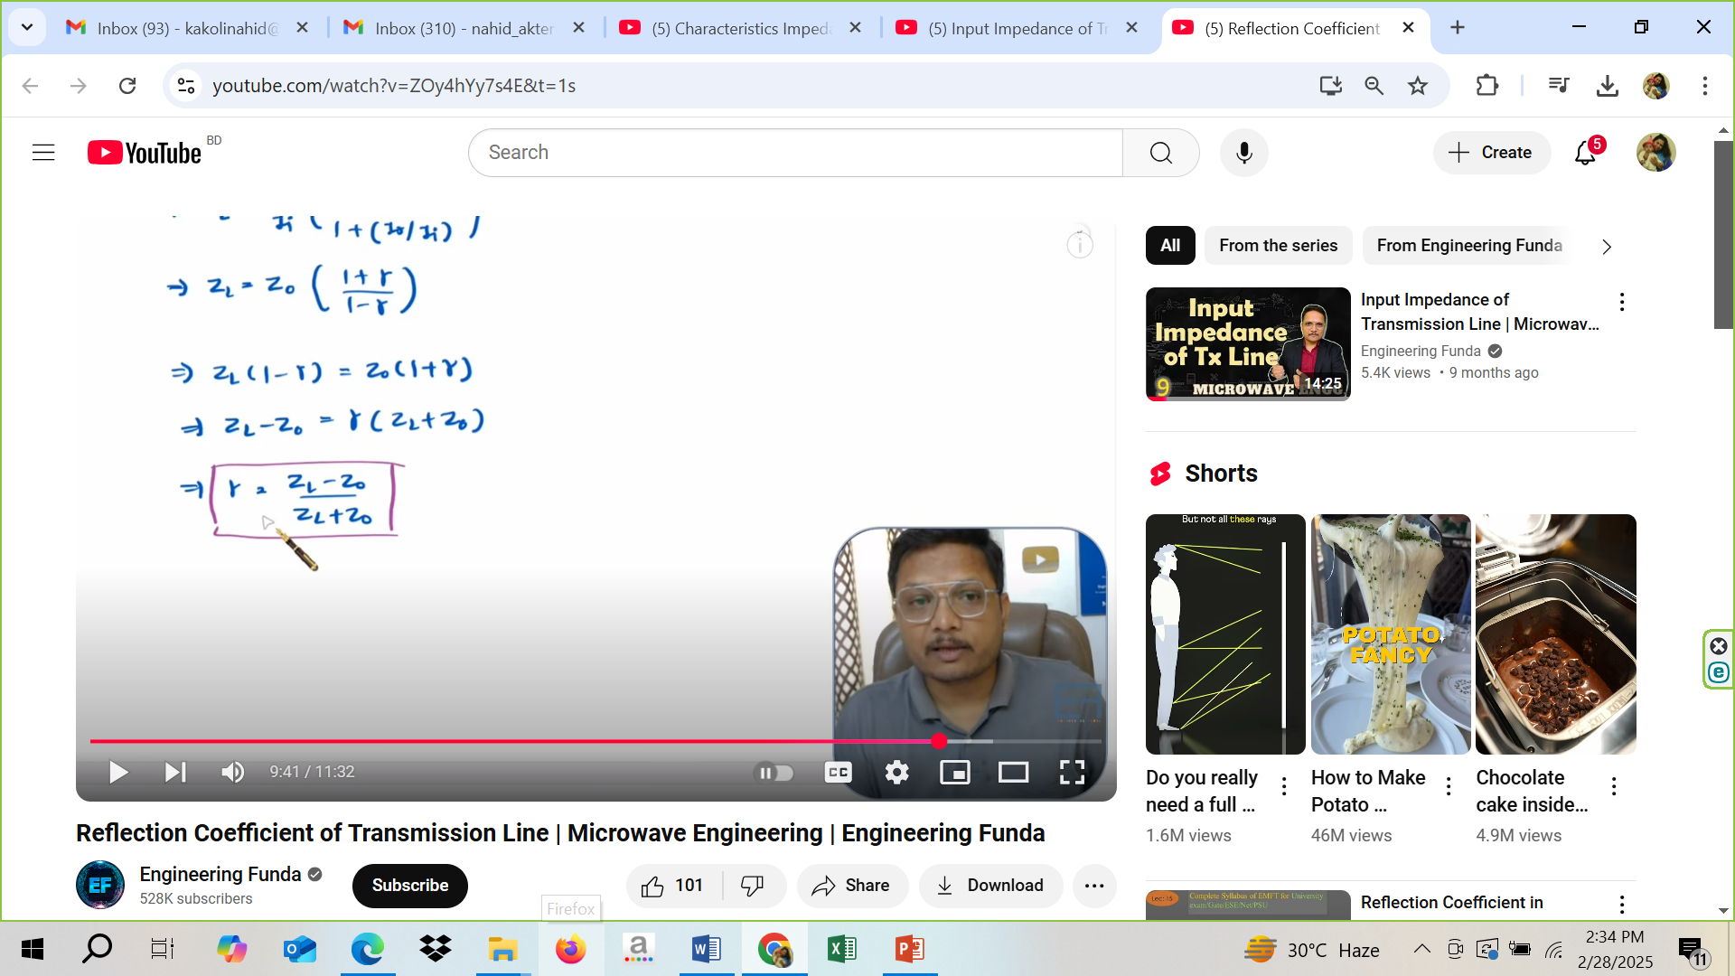

Slide 19
Voltage Standing wave ratio

Slide 20
Voltage Standing wave ratio
VSWR (Voltage Standing Wave Ratio) is a measure of how efficiently radio-frequency power is transmitted from a power source, through a transmission line, into a load.

Slide 21
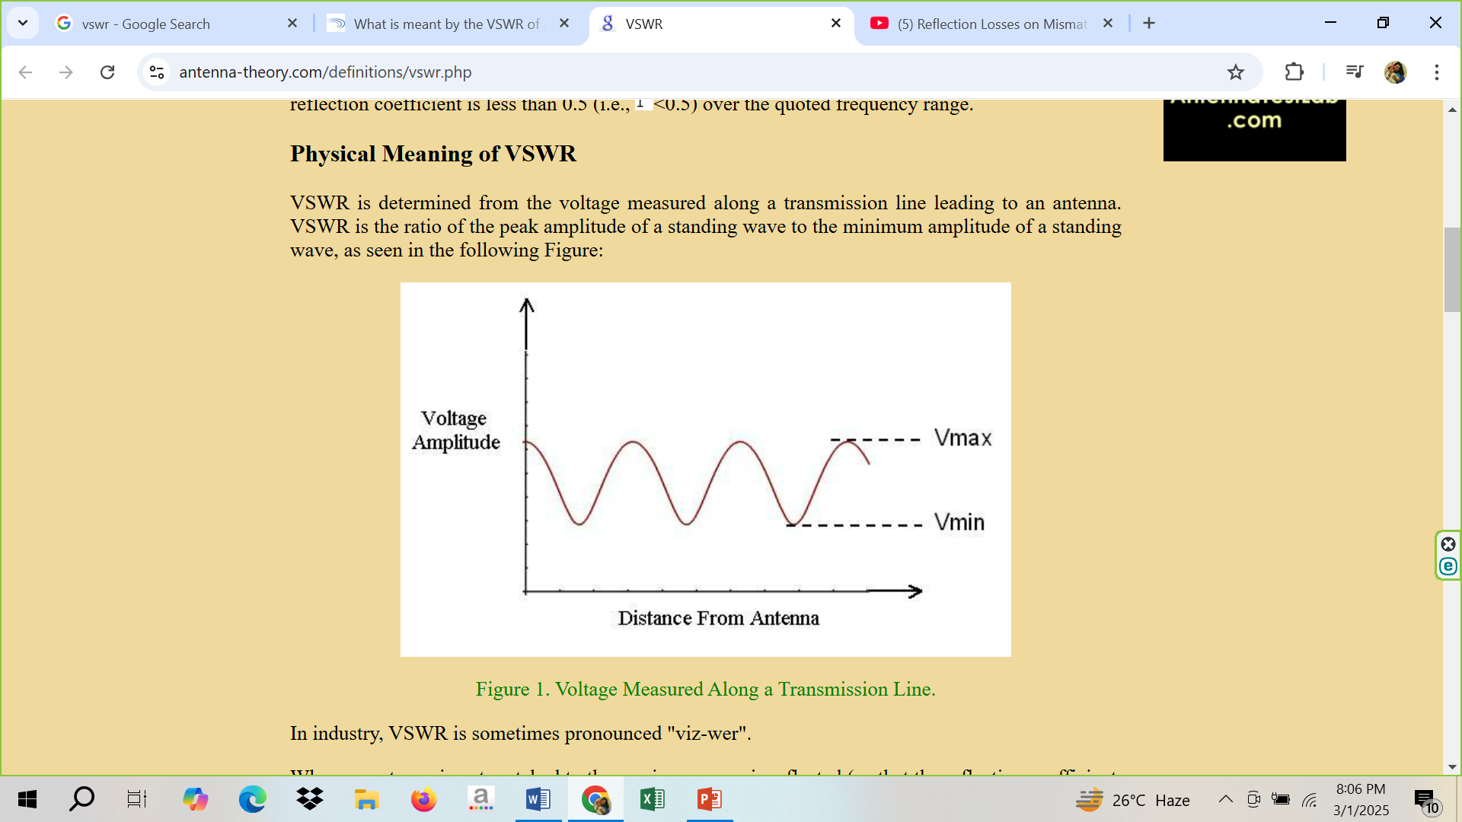
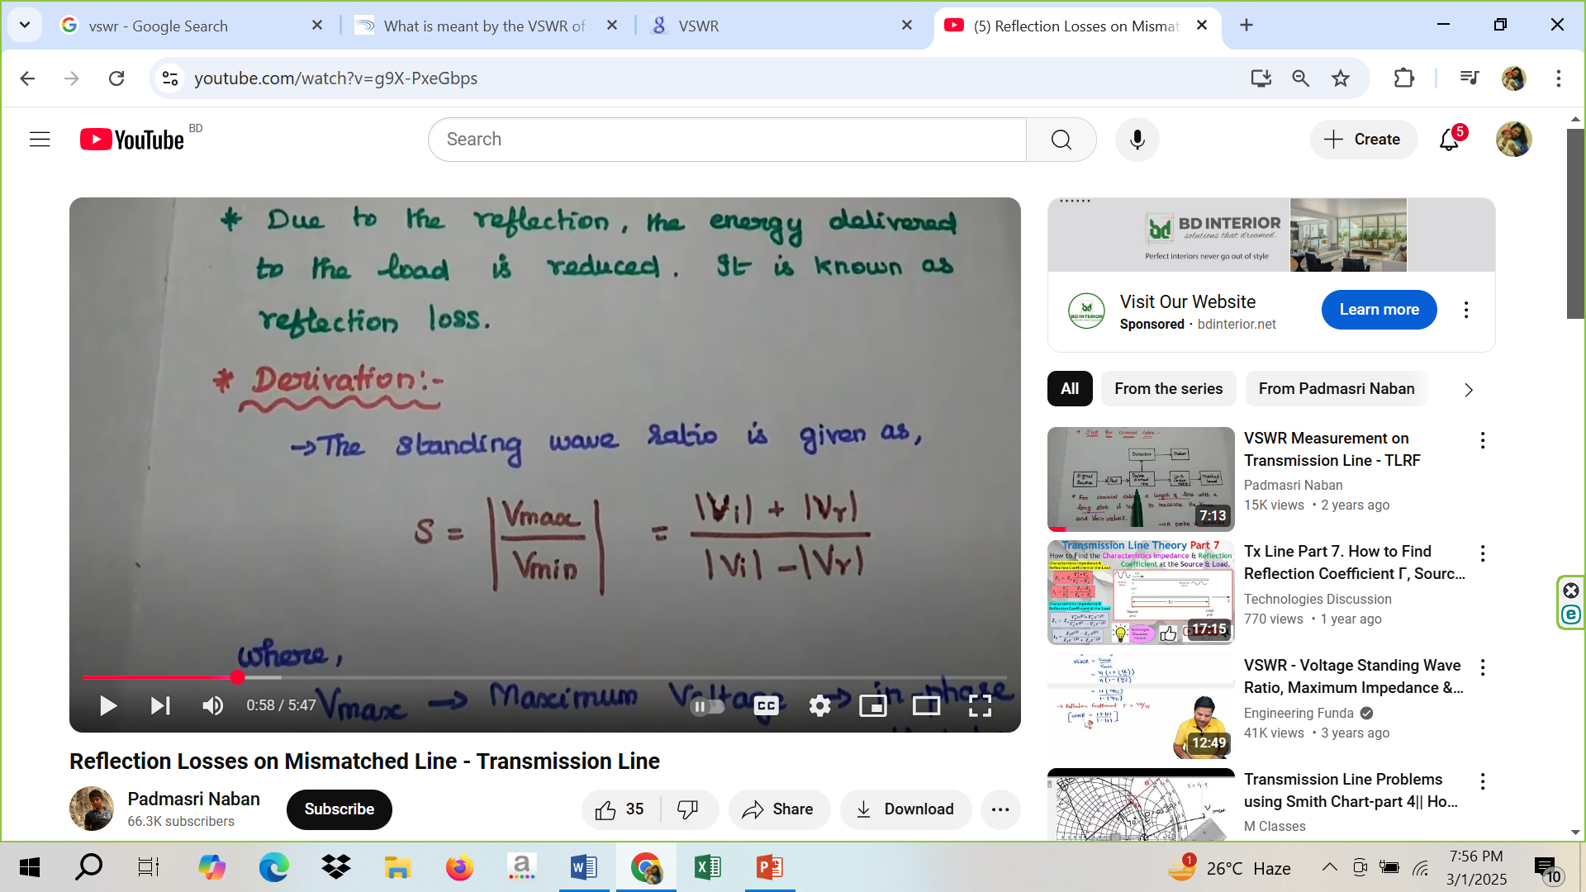
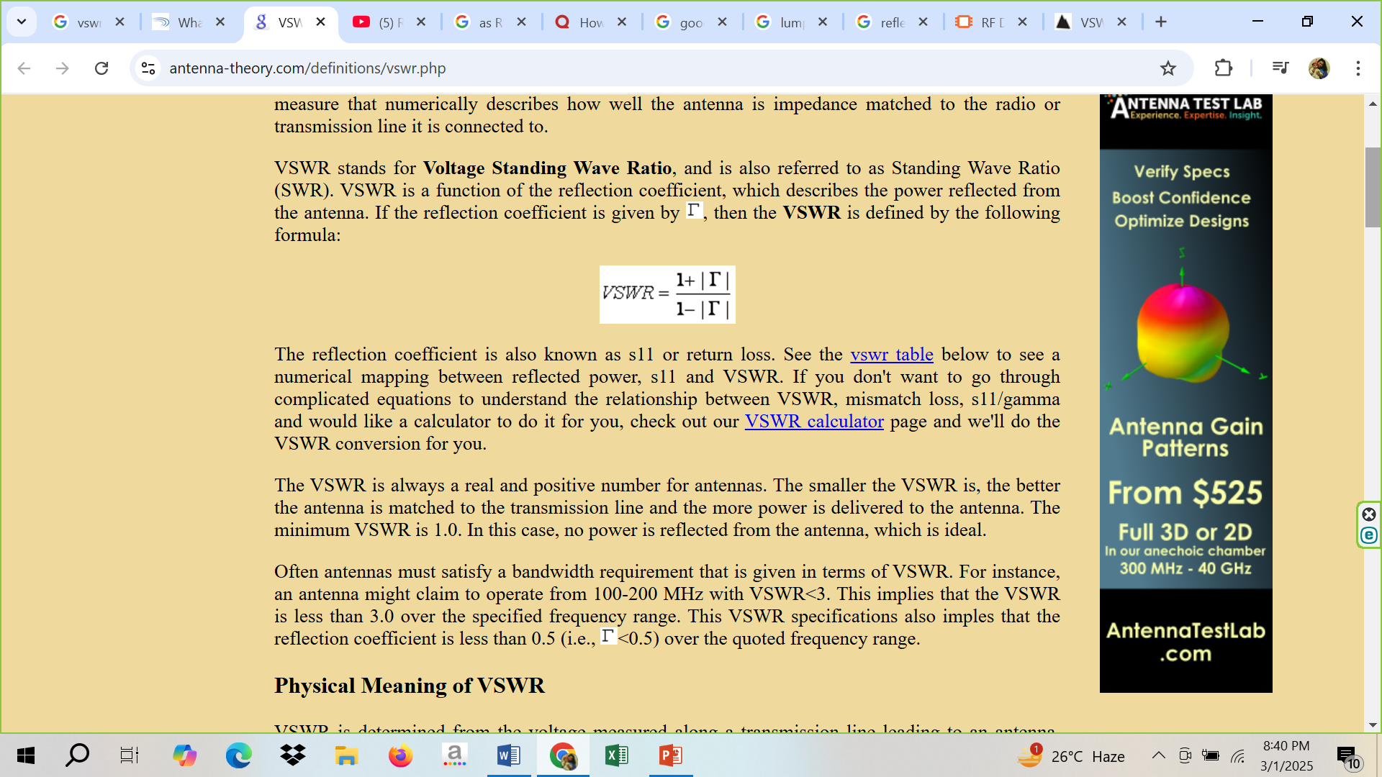
Voltage Standing wave ratio
VSWR is the ratio of the peak amplitude of a standing wave to the minimum amplitude of a standing wave.

Slide 22
Voltage Standing wave ratio
For a radio (transmitter or receiver) to deliver power to an antenna, the impedance of the radio and transmission line must be well matched to the antenna's impedance. The parameter VSWR is a measure that numerically describes how well the antenna is impedance matched to the radio or transmission line it is connected to.

Slide 23
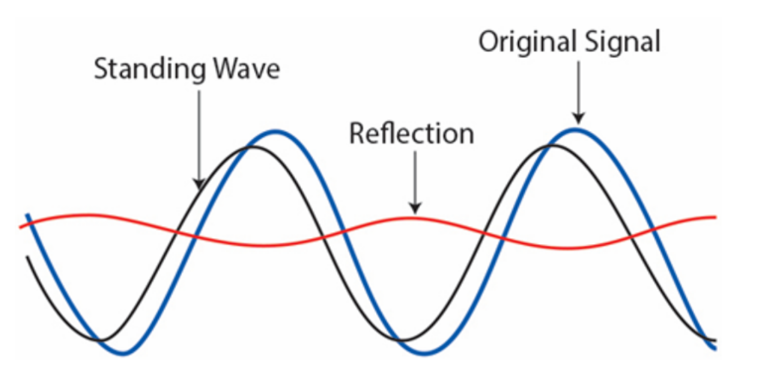

Slide 24
Note
The range of reflection loss in a transmission line is typically from 0 dB (no reflection) to infinity (∞) dB (total reflection).
The range of Voltage Standing Wave Ratio (VSWR) in a transmission line is from 1 to infinity (∞), where a value of 1 indicates a perfect impedance match and a higher value represents increasing mismatch and reflection of signals.

Slide 25
Homework
Problem-Solution
A 30 meter long lossless transmission line with Z₀=50 ohm operating at 2 MHz is terminated with the load Z_{L}=60+j40 ohm. If u=0.6c on the line. Find-
The reflection coefficient
The standing wave ratio
The input impedance

